Slide 1
Title: Credit Risk Assessment
CSE 343: Machine Learning Mid-Project Presentation

Slide 2
Motivation
The lending landscape has undergone a significant transformation with the advent of platforms like LendingClub, the world’s largest peer-to-peer lending platform.
In response to a surge in loan applications, the importance of precise credit risk assessment has never been more pronounced. This report presents a comprehensive case study focused on LendingClub, a pioneering peer-to-peer lending company based in the United States.
Our primary objective is to uncover the intricacies of risk analytics within the banking and financial services sector, particularly within the context of urban customers.

Slide 3
At the heart of this challenge lies the decision-making process upon receiving a loan application. Striking a balance between two types of risks is imperative:
1. Potential Loss of Business: Denying a loan to a credible applicant directly translates to a loss of business for the company.
2. Risk of Default: Conversely, approving a loan for an applicant likely to default could lead to financial repercussions.

Slide 4
The provided dataset encompasses historical data of past loan applicants and their respective repayment behaviors.
Our aim is to unearth discernible patterns that act as indicators of default.
These insights could play a pivotal role in making informed decisions, such as adjusting loan amounts, assigning higher interest rates to riskier applicants, or even in some cases, denying loans.

Slide 5
Through a thorough examination of the data using exploratory data analysis (EDA) and leveraging machine learning techniques, we aspire to construct a robust framework for identifying high-risk loan applicants.
Ultimately, our goal is to empower lending institutions with the knowledge and tools to minimize credit loss and optimize their lending portfolios.

Slide 6
Literature Review
In the realm of credit risk assessment, significant strides have been made, with researchers exploring various facets of lending risk prediction. This section provides an overview of seminal works that have paved the way for understanding and addressing challenges in this domain.
1. Consumer Credit Risk Assessment - Jonathan N. Crook, David B. Edelman, and Lyn C. Thomas delve into the realm of classification algorithms and profit scoring, shedding light on their application in the prediction of lending risks [1]

Slide 7
Methods -
This study focuses on consumer credit risk assessment, employing logistic regression and various classifiers. While support vector machines offer high accuracy, practical application is impeded by data quality issues. Training on accepted applicants introduces challenges in setting cut-off values. Profit scoring and the Basel 2 accord significantly influence research directions.
Conclusion -
This review delves into contemporary research in consumer credit risk assessment, emphasizing logistic regression's prevalence. It underscores credit scoring's evolution and the Basel 2 Accord's impact on global banking regulations. The study sets the stage for refining credit risk assessment models.

Slide 8
2. P2P Loan Acceptance & Default Prediction with AI Kenneth Kennedy’s thesis provides valuable insights into the challenges faced in the development of credit scorecards, with a particular focus on issues like class imbalance and low-default portfolios [2]
Methods -
This thesis conducts a comprehensive analysis of credit scoring, a critical aspect of lending decisions for financial institutions. It addresses challenges in developing accurate credit scorecards, focusing on imbalanced datasets. The study evaluates various supervised classification techniques, highlighting the intricacies of class imbalance. Additionally, it addresses the low-default portfolio problem by comparing semi-supervised classification methods with logistic regression.

Slide 9
Conclusion -
This research underscores the paramount importance of credit scoring in lending decisions for financial institutions and the broader economy. It highlights four key contributions, including insights into handling imbalanced datasets and addressing the low-default portfolio problem. The study emphasizes the need for precision in dataset implementation and introduces artificial data as a resourceful solution when real-world data is unavailable.

Slide 10
3. Deep Learning Credit Risk Modeling - J. D. Turiel and T. Aste employ cutting-edge deep learning techniques to forecast loan acceptance and default risk in peer-to-peer lending credit risk models [3].
Methods -
This research employs logistic regression (LR), support vector machine algorithms, and deep neural networks (DNNs) to replicate lending decisions and predict default probabilities. A two-phase model is proposed, where the first phase predicts loan rejection, and the second predicts default risk for approved loans. LR performs exceptionally in the first phase, achieving a test set recall macro score of 77.4%.

Slide 11
Conclusion -
This study underscores the critical role of credit scoring in lending decisions for financial institutions and the broader economy. It introduces a novel two-phase model for loan assessment, demonstrating the effectiveness of LR and DNNs. The research not only advances credit risk modeling but also presents a pathway to making credit access fairer and more accessible, particularly for small businesses.

Slide 12
Dataset Description
Utilized the LendingClub loan data from Kaggle spanning 2007 to 2018.
The original dataset had 2 million rows and 151 features.
Carefully selected relevant features based on the LC dictionary.
Excluded features with substantial missing values for precision.
Ensured each chosen feature had a clear definition and relevance.
Performed In -depth EDA to gain valuable insights from the data

Slide 13
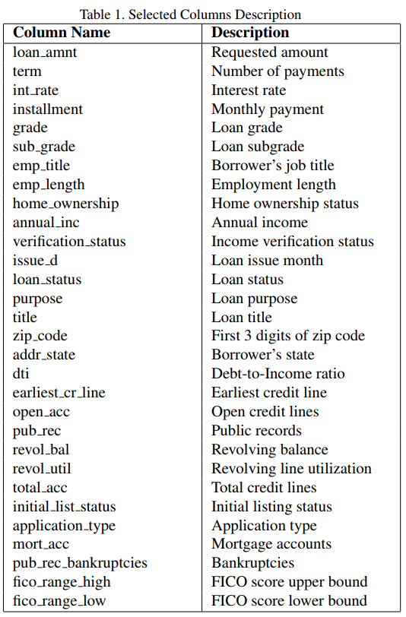
Attributes
A target variable (loan status) is defined to include only ’Fully Paid’ and ’Charged Off’ statuses.
Focused on loans with conclusive outcomes, excluding ongoing loans and credit policy exceptions.

Slide 14
Feature Selection & Feature Engineering:
Removed certain features, such as issue_d, to prevent data leakage.
Focused on features available at the time of loan origination to ensure accurate assessments.
Constructed an additional feature by computing the average FICO score utilizing the 'fico_range_low' and 'fico_range_high' attributes, enhancing the model's predictive capability.

Slide 15
Data Encoding
One-Hot Encoding - Applied one-hot encoding to specific categorical features, including 'verification_status,' 'purpose,' 'initial_list_status,' 'application_type,' 'home_ownership,' and 'addr_state,' creating dummy variables for each category.
Label Encoding - Utilized label encoding with numerical conversion for categorical variables such as 'emp_length' and 'sub_grade,' ensuring compatibility with the model's requirements.

Slide 16
Data Encoding
Conversion to Numerical Data - Cleaned and converted selected columns to numeric format, ensuring their suitability for further analysis and modeling.
Data Cleaning - Eliminated rows with missing values amounting to less than 5% of total data in the newly processed features, ensuring a cleaner and more complete dataset for analysis.

Slide 17
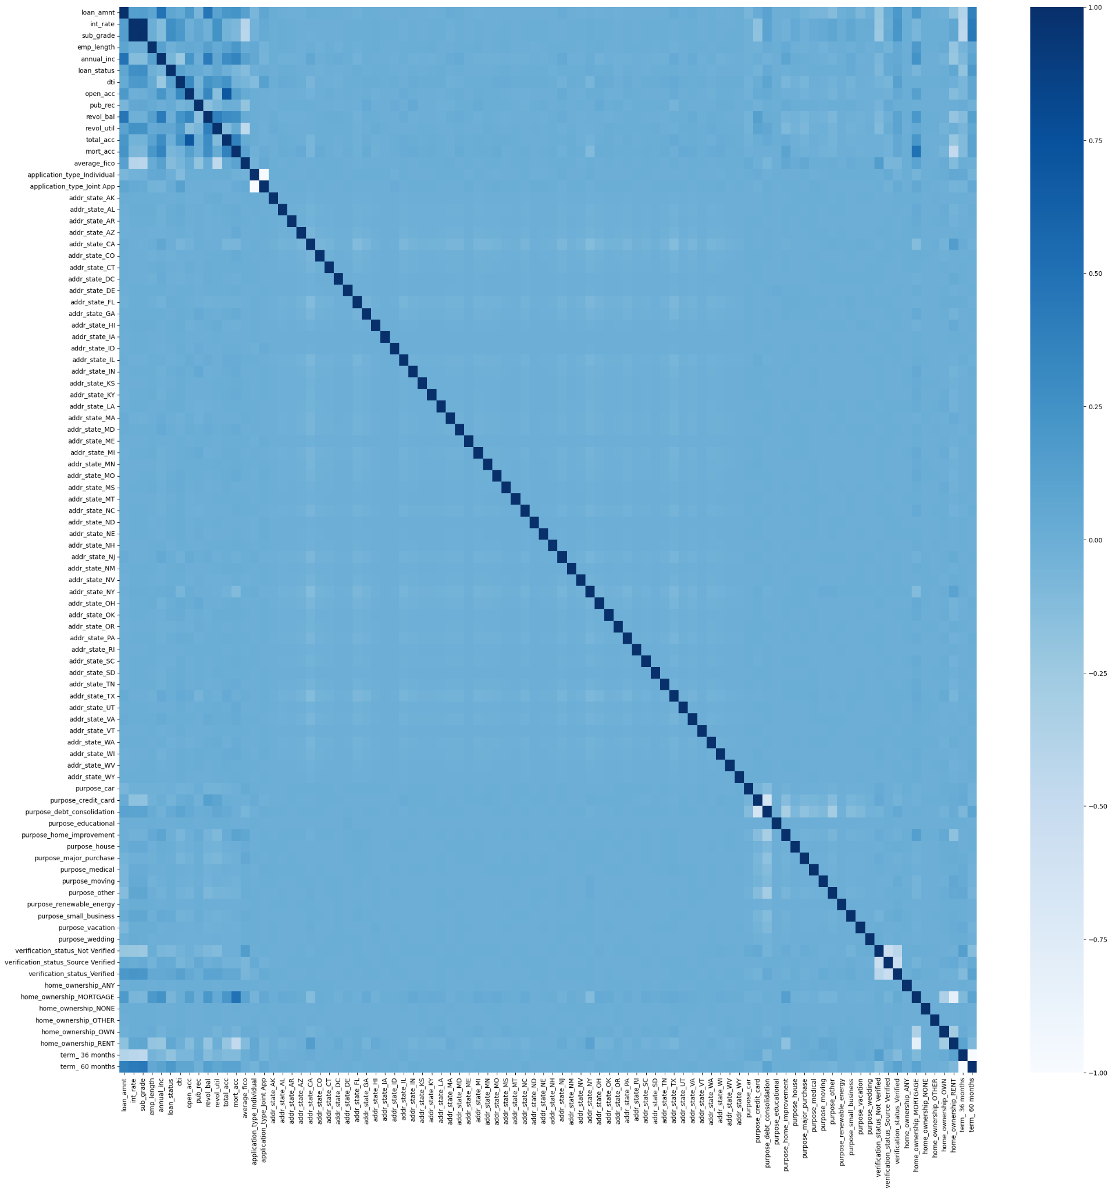
Visualization
Heatmap to verify the correlation between columns.
Majority of the columns are not highly correlated.

Slide 18
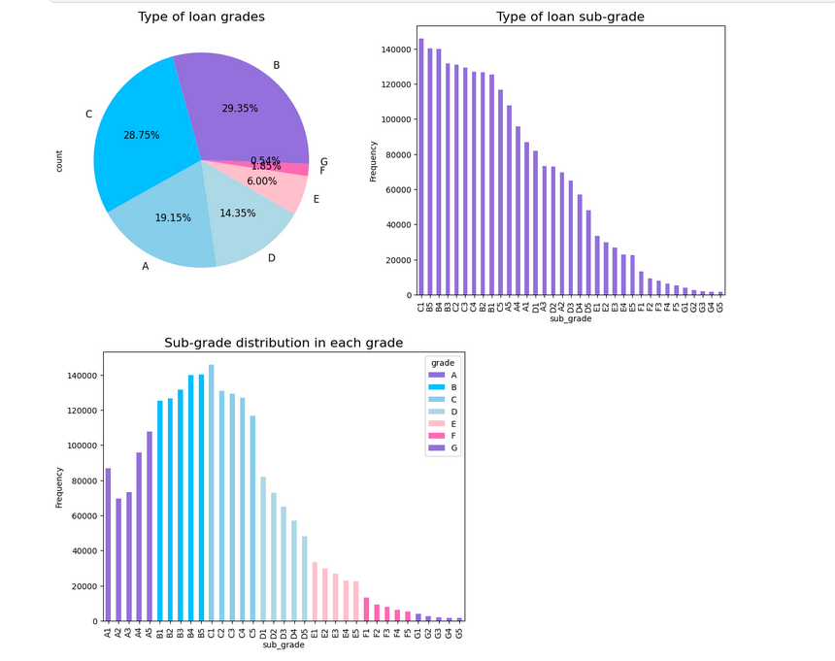
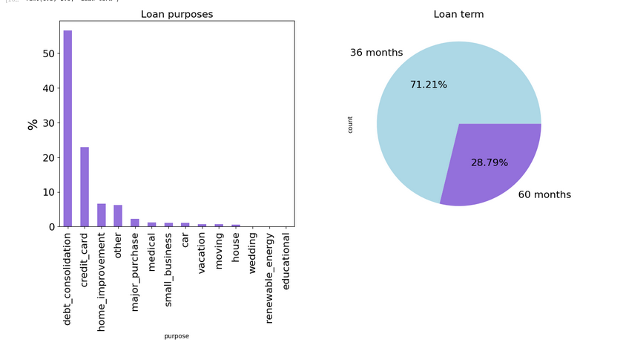
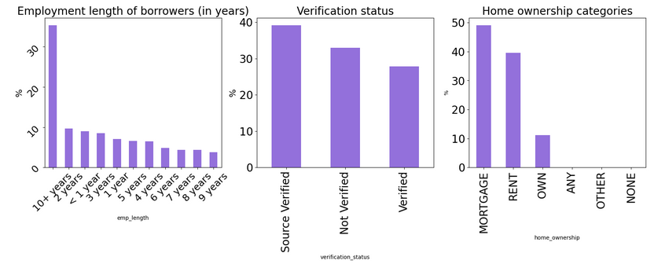
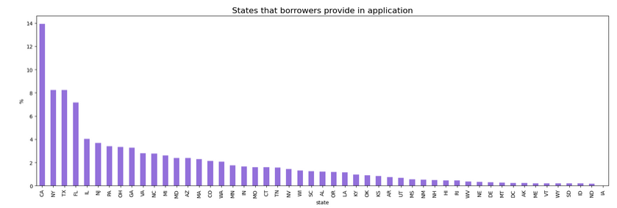
Visualization (EDA)

Slide 19
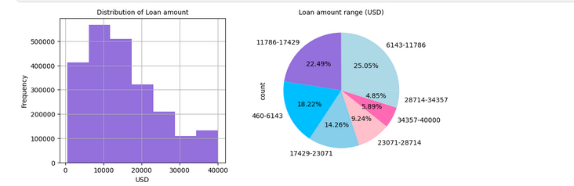
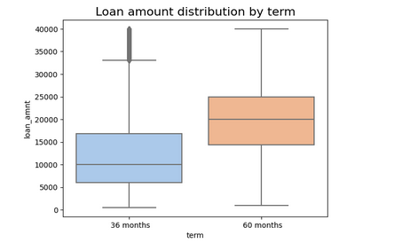
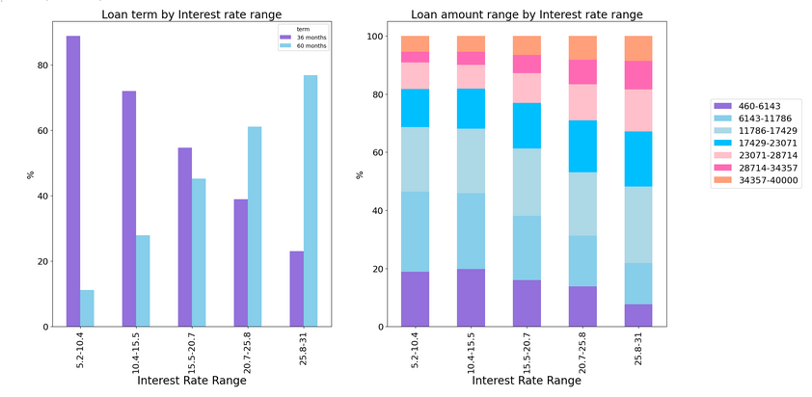
Visualization (EDA)

Slide 20
EDA Inferences
Loan Amount Trends:
Varied loan amounts from $460 to $40,000 USD.
Common range: $6,143-$11,786, indicating a prevalent choice.
Skewed distribution, fewer loans above $17,429.
Interest Rate Insights:
41.4% with interest rates between 10.4% and 15.5%.
Right-skewed loan amount data suggests rates of 5.2% to 15.5%.
FICO Scores and Applicants:
71% with good FICO scores; 675 is most frequent.
Rarity in applicants with FICO scores above 800.
Loan Purpose and Term Preferences:
Majority for debt consolidation and credit cards.
71.2% prefer 36-month terms over 60 months.
Loan Grades and Risk Assessment:
Primary grades: A (19%), B (29%), C (28%).
Higher-risk categories (E, F, G) have fewer loans.
Applicant Characteristics:
10% unemployed or less than a year of work; 35% employed for over ten years.
50% have a mortgage; 40% pay rent.
Loan Status and Types:
48% fully paid; 40% current; 30% charged off.
Majority (94%) are individual applications; 6% joint applications.

Slide 21
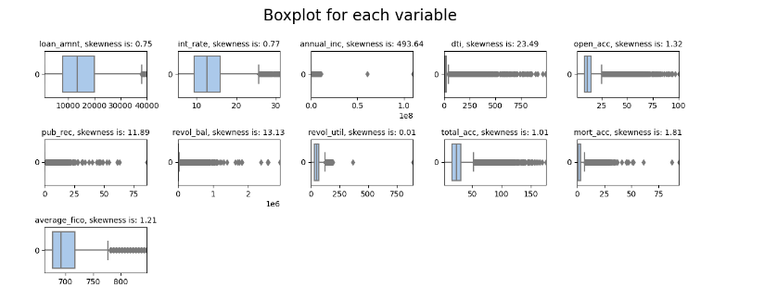
Visualization
Box plots to check for potential outliers.

Slide 22
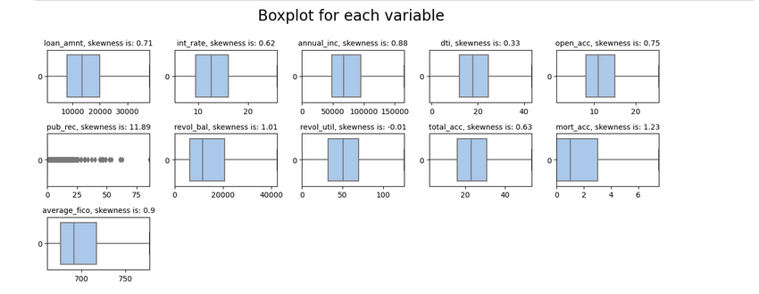
Visualization
Box plots of features after outlier capping process

Slide 23
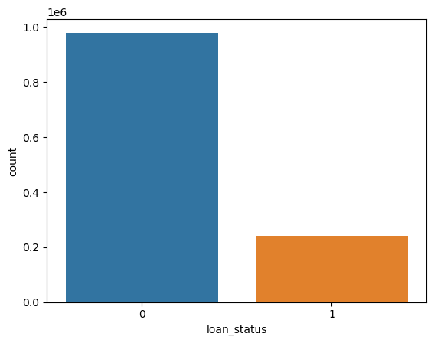
Visualization
Observing the imbalance in dataset.

Slide 24
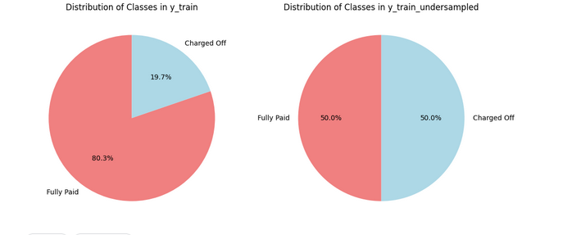
Visualization
Mitigated class imbalance through random undersampling of the data.

Slide 25
Methodology
Logistic Regression - We used logistic regression model for binary classification using L2 regularization and log loss with inverse of regularization constant = 1. This model is evaluated using accuracy, confusion matrix, and an ROC curve.
Random Forest - We used random forest of decision trees with gini criterion. This model is evaluated using ROC-AUC score.
Naive Bayes - We also used Naive Bayes model for our prediction. This model is evaluated based on accuracy, a confusion matrix and a classification report.

Slide 26
Methodology
K-nearest neighbor: A K-Nearest Neighbors Classifier is trained after data imputation and standardization. This model is evaluated based on ROC-AUC score.
Support Vector Machine (SVM): This model is evaluated using accuracy, a confusion matrix, and a ROC curve.

Slide 27
Methodology
XG-Boost: This model is evaluated using accuracy, a confusion matrix, a training curve vs epochs, and an ROC curve.
ANN: This model is also evaluated using accuracy, a confusion matrix, a training curve vs epochs, and an ROC curve.
Note -
All the models are based on under-sampled data.

Slide 28
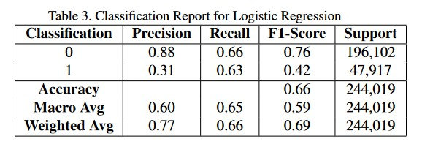
Analysis
Logistic Regression -

Slide 29
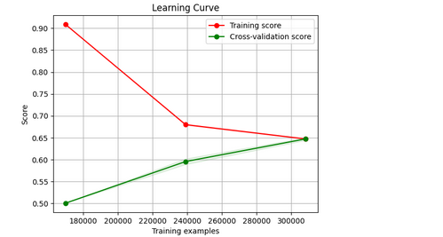
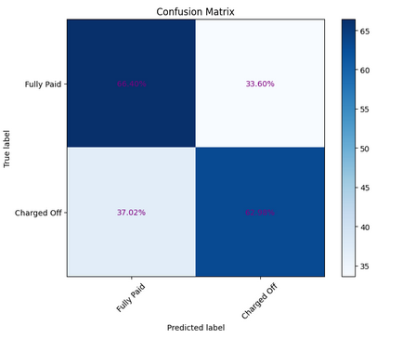
Analysis
Logistic Regression -

Slide 30
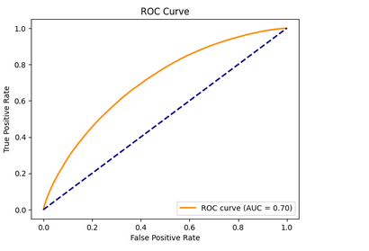
Logistic Regression -

Slide 31
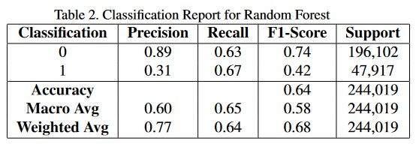
Random Forest -

Slide 32
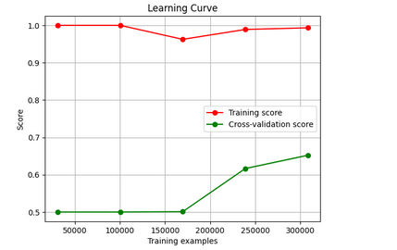
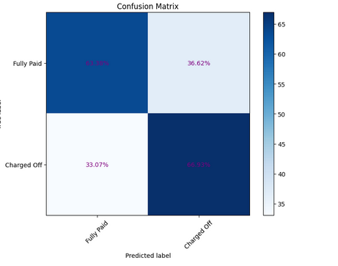
Analysis
Random Forest-

Slide 33
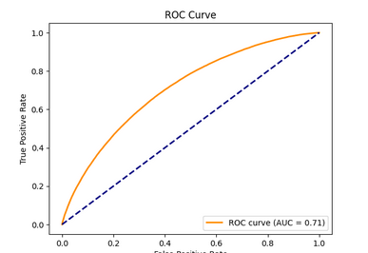
Random Forest -

Slide 34
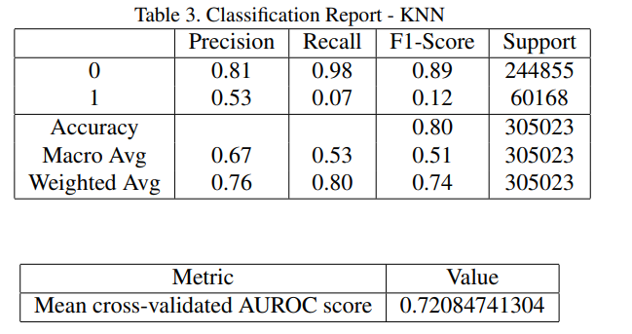
K - Nearest Neighbors -

Slide 35
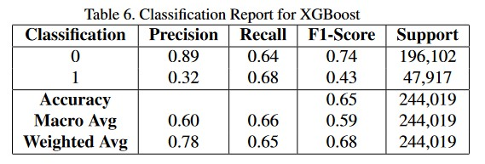
XG Boost -

Slide 36
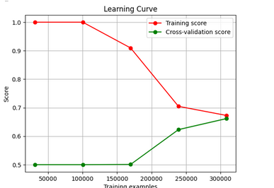
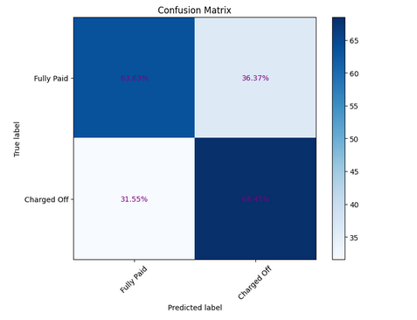
XG Boost -

Slide 37
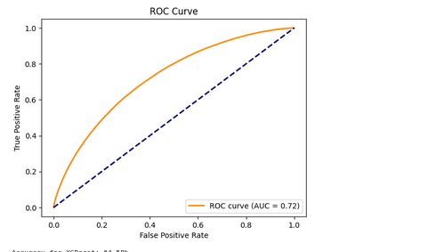
XG Boost -

Slide 38
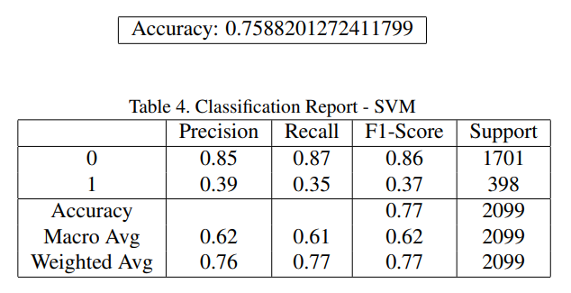
SVM -

Slide 39
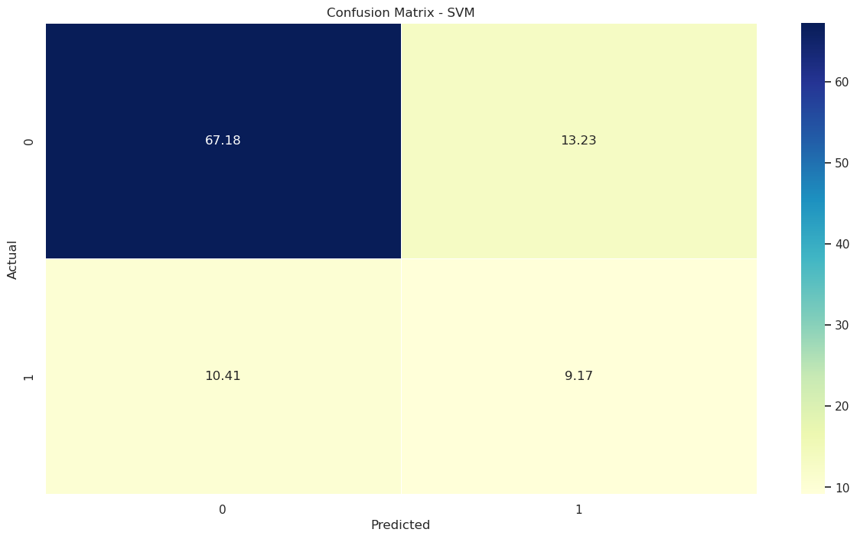
SVM -

Slide 40
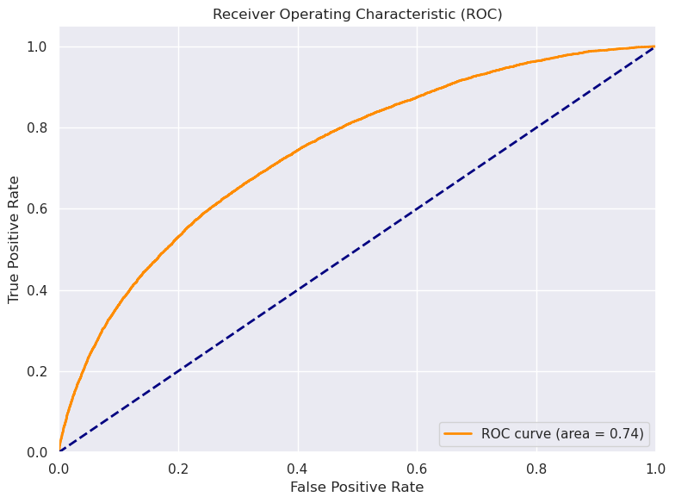
SVM -

Slide 41
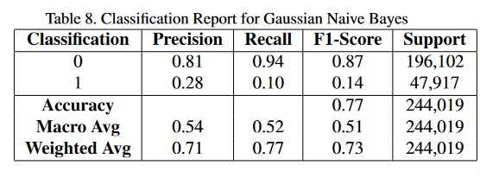
Naive Bayes -

Slide 42
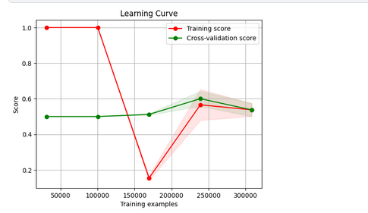
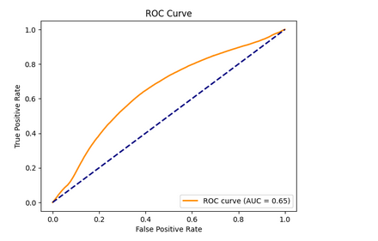
Naive Bayes -

Slide 43
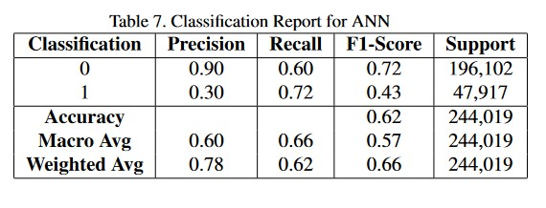
ANN -

Slide 44
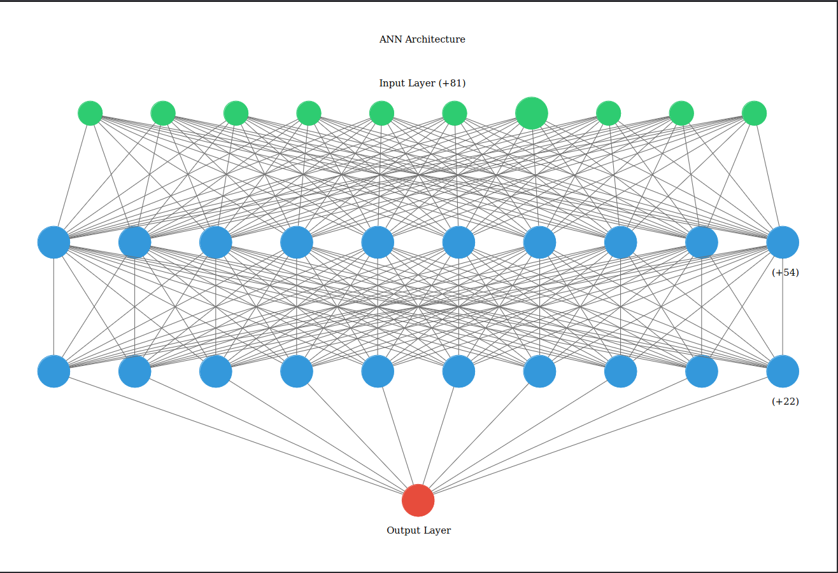
ANN -

Slide 45
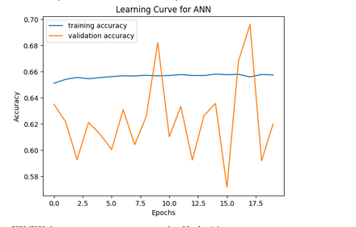
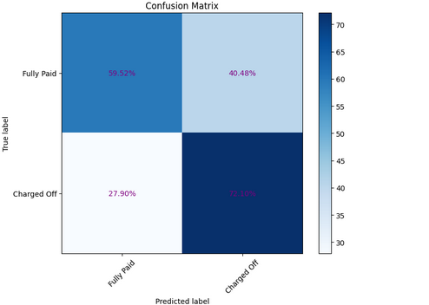
ANN -

Slide 46
Inference
Logistic Regression model was the most effective because of it’s higher precision, thus, lowering actual defaults.
Lowering defaults is one of the main goals for this prediction.
XG Boost is next to Logistic Regression in terms of performance.

Slide 47
Inference
Precision -
Use - Focuses on the accuracy of positive predictions. It's the proportion of true positives out of all positive predictions.
Considerations - Useful when false positives are costly (e.g., approving a risky loan).
Recall (Sensitivity, True Positive Rate) -
Use - Focuses on capturing as many actual positives as possible. It's the proportion of true positives out of all actual positives.
Considerations - Important when false negatives are costly (e.g., missing a genuine loan).

Slide 48
Inference
F1-Score -
Use - Harmonic mean of precision and recall. Balances both precision and recall.
Considerations - Suitable when you want a balance between false positives and false negatives.
Based on Average F1-Scores too, Logistic Regression has comparatively better performance, with the weighted average F1-Score of 69%.

Slide 49
Mid-Project Timeline
Here’s the proposed weekly timeline for the project -
• Week 1 - Literature review on credit risk assessment.
• Week 2 - Collect and preprocess credit data.
• Week 3 - Implement and train ML models.
• Week 4 - Experiment with deep learning methods.
• Week 5 - Evaluate model performance metrics.
• Week 6 - Explore alternative data integration.
• Week 7 - Fine-tune models and hyperparameters.
• Week 8 - Write and finalize project report.
• Week 9 - Prepare and practice project presentation.
• Week 10 - Submit project report, give presentation.

Slide 50
Final-Project Timeline
• Week 5 - Experiment with deep learning methods.
• Week 6 - Explore alternative data integration.
• Week 7 - Fine-tune models and hyperparameters.
• Week 8 - Write and finalize project report.
• Week 9 - Submit project report, give presentation

Slide 51
Timeline
We’ve been able to follow the timeline, as proposed earlier, including experimenting with some Deep Learning Techniques, such as ANN.
We’ve also included models such as XG-Boost, in our final presentation as well, in addition to all the other previous models.

Slide 52
Contributions (Group 52)
Nikhil Suri (2021268) - Implementation of ML models, Mid-Project Report, Slides, Inferences, Final Project Report.
Maanas Gaur (2021537) - Data Pre-Processing & Datacleaning, Slides, ANN & XG-Boost, re-training models after undersampling.
Adish Jain (2021227) - Debugging ML training code, Slides, Verification of Results & Inferences, ANN.

